Slide 1
至死忠心的信
Be Faithful unto Death
啟示錄 Revelation 2:8-11

Slide 2
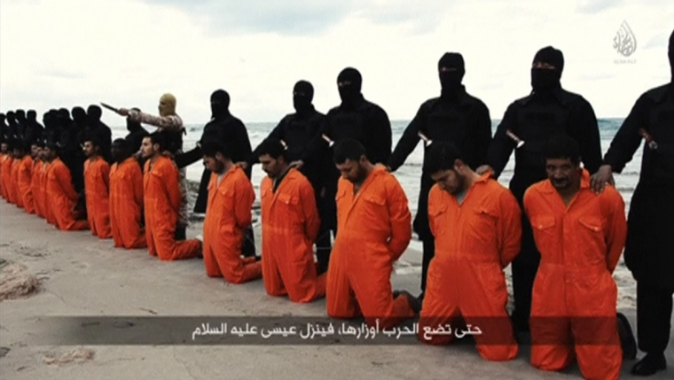
ISIS beheaded 21 Egyptian Christians on February, 2015
Notes:
http://time.com/3718470/isis-copts-egypt/
http://www.dailymail.co.uk/news/article-3045711/Slaughter-beach-ISIS-behead-shoot-Ethiopian-Christians-sickening-new-propaganda-video.html

Slide 3
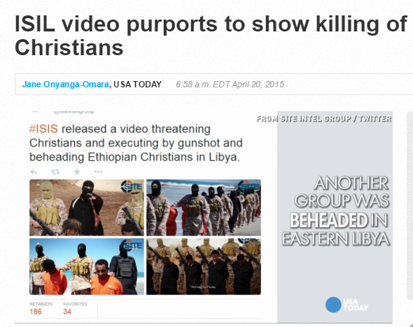
ISIS 30 Ethiopian Christians on April, 2015
Notes:
http://www.usatoday.com/story/news/world/2015/04/19/isil-ethiopian-christians/26026769/

Slide 4

Notes:
http://www.usatoday.com/story/news/nation/2015/06/17/charleston-south-carolina-shooting/28902017/

Slide 5
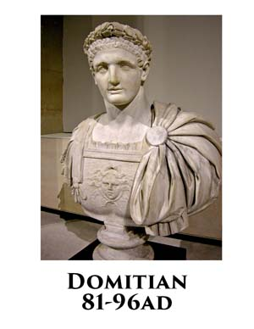


Slide 6
1. 患難中最大的安慰是「神知道」
The Best Comfort in Suffering is “God Knows”
Revelation 2:9
⁹ 我知道你的患難，你的貧窮（你卻是富足的），也知道那自稱是猶太人所說的毀謗話，其實他們不是猶太人，乃是撒但一會的人。
⁹ I know your afflictions and your poverty—yet you are rich! I know about the slander of those who say they are Jews and are not, but are a synagogue of Satan.

Slide 7
1. 患難中最大的安慰是「神知道」
The Best Comfort in Suffering is “God Knows”
Revelation 2:8
⁸ 「你要寫信給士每拿教會的使者，說：『那首先的、末後的、死過又活的，說：
⁸ “To the angel of the church in Smyrna write: These are the words of him who is the First and the Last, who died and came to life again.

Slide 8
Hebrews 4:16
¹⁶ 所以，我們只管坦然無懼地來到施恩的寶座前，為要得憐恤，蒙恩惠，作隨時的幫助。
¹⁶ Let us then approach God’s throne of grace with confidence, so that we may receive mercy and find grace to help us in our time of need.

Slide 9
2. 患難中最大的誤會是「逢凶化吉」
The Biggest Misunderstanding about Suffering is “You will be fine”

Slide 10
Revelation 2:10
¹⁰ 你將要受的苦你不用怕。魔鬼要把你們中間幾個人下在監裏，叫你們被試煉，你們必受患難十日。你務要至死忠心，我就賜給你那生命的冠冕。
¹⁰ Do not be afraid of what you are about to suffer. I tell you, the devil will put some of you in prison to test you, and you will suffer persecution for ten days. Be faithful, even to the point of death, and I will give you life as your victor’s crown.

Slide 11
1 Corinthians 4:9
⁹ …因為我們成了一臺戲，給世人和天使觀看。
⁹ … We have been made a spectacle to the whole universe, to angels as well as to human beings.

Slide 12
3. 患難中最要緊的是「通過考驗」
The Most Important Objective of Suffering is to Pass the Test
Revelation 2:10
¹⁰ 你將要受的苦你不用怕。
¹⁰ Do not be afraid of what you are about to suffer.

Slide 13


Slide 14
Revelation 2:10
¹⁰ 你將要受的苦你不用怕。… 你務要至死忠心，我就賜給你那生命的冠冕。
¹⁰ Do not be afraid of what you are about to suffer. … Be faithful, even to the point of death, and I will give you life as your victor’s crown.

Slide 15
Revelation 7:15–17 所以，他們在上帝寶座前，晝夜在他殿中事奉他。坐寶座的要用帳幕覆庇他們。¹⁶ 他們不再飢，不再渴；日頭和炎熱也必不傷害他們。¹⁷ 因為寶座中的羔羊必牧養他們，領他們到生命水的泉源；上帝也必擦去他們一切的眼淚。」
¹⁵ Therefore, “they are before the throne of God and serve him day and night in his temple; and he who sits on the throne will shelter them with his presence. ¹⁶ ‘Never again will they hunger; never again will they thirst. The sun will not beat down on them,’ nor any scorching heat. ¹⁷ For the Lamb at the center of the throne will be their shepherd; ‘he will lead them to springs of living water.’ ‘And God will wipe away every tear from their eyes.’”

Slide 16
¹¹ 聖靈向眾教會所說的話，凡有耳的，就應當聽！得勝的，必不受第二次死的害。』」
¹¹ Whoever has ears, let them hear what the Spirit says to the churches. The one who is victorious will not be hurt at all by the second death.

Slide 17
Isaiah 49:15
¹⁵ 婦人焉能忘記她吃奶的嬰孩， 不憐恤她所生的兒子？ 即或有忘記的， 我卻不忘記你。
¹⁵ “Can a mother forget the baby at her breast and have no compassion on the child she has borne? Though she may forget, I will not forget you!

Slide 18
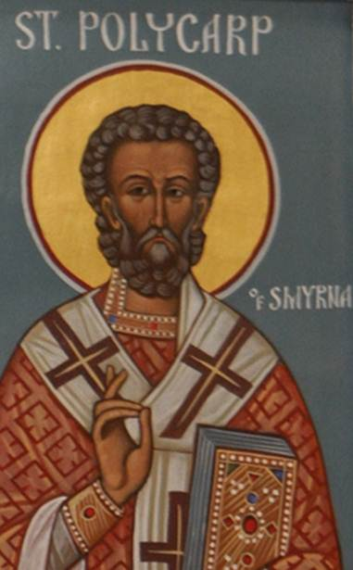
坡旅甲
Polycarp
(c. 70–156)
Notes:
Gonzalez, “The Story of Christianity”, 43-45
Lightfoot, Joseph Barber, and J. R. Harmer. The Apostolic Fathers. London: Macmillan and Co., 1891.

Slide 19
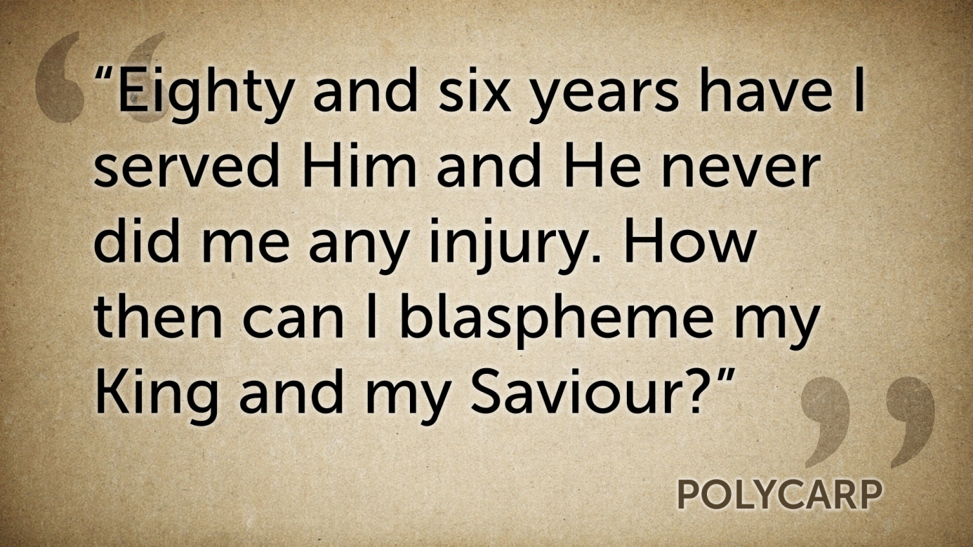

Slide 20
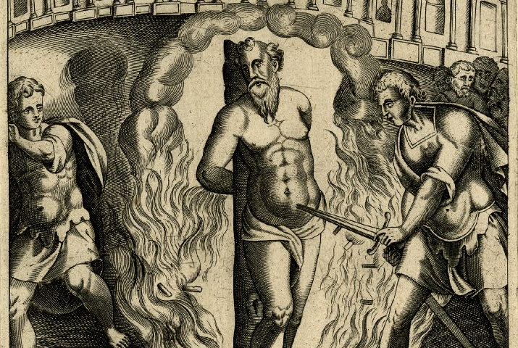

Slide 21
